Slide 1
US vs Foreign WTIV Results
National Gaps – Vessel Study
7/15/2024

Slide 2
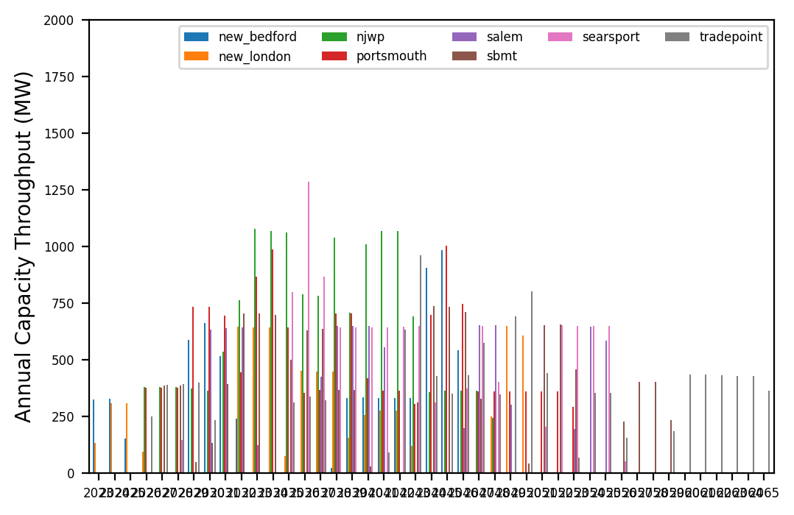
Port Throughput Adjustment
Port Throughput
Adjusted fasten/takt times in foundation and turbine phases to achieve:
600 MW/yr for turbine install
600 MW/yr for foundation install
Turbine installation begins when foundations are 25% complete to achieve reasonable project completion timeline

Slide 3
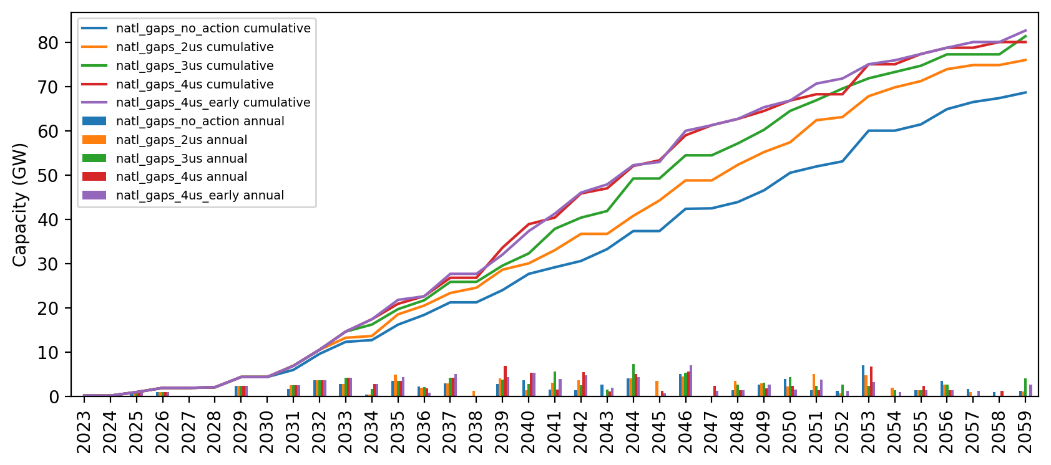
US WTIV Cumulative Capacity
New US WTIV added every 3 years starting in 2030
Port throughput adjusted, use 75% for foundation and turbine install
US WTIVs assigned to projects based on foundation type and associated port
4 US WTIVs is optimal with these assumptions
Installed Capacity Given US WTIV Availability

Slide 4
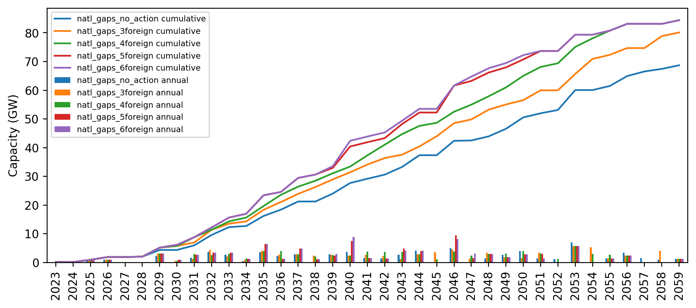
Foreign WTIV/US Feeder Cumulative Capacity
All feeders added at the beginning of the pipeline
5 foreign WTIVs with 10 US feeders is optimal
Installed Capacity Given US WTIV Availability

